Slide 1
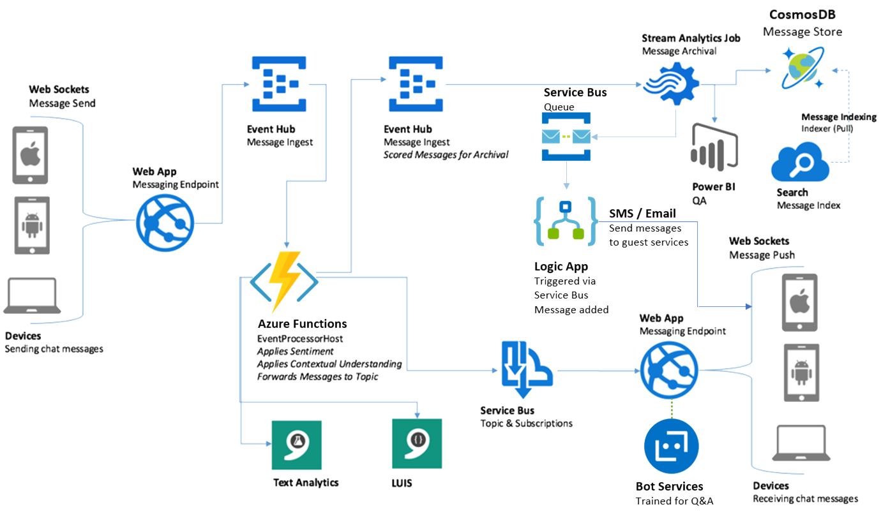



SMS / Email
Send messages
to guest device
Logic App
Triggered via
Service Bus
Message added
Azure Functions
Bot Services
Trained for Q&A

